Slide 1

IMDB REVIEWS SENTIMENT ANALYSIS
Team 4
Aishwarya arab,
prakruti rajendra kothari,
shubham sharad khaladkar

Slide 2
Introduction
IMDB is one of the most popular websites for movie watchers to review the movies.
The success or failure of a movie largely depends on the audience reviews.
Sentiment analysis is a process in which the textual data is interpreted to understand the underlying emotion.
Many companies that deal with massive amounts of textual data are reaping the benefits of sentiment analysis to understand the concerns of customers, performing market research, and overall sentiment of users regarding the products or services offered.
The objective of this project is to perform sentiment analysis utilizing NLP techniques on IMDB movie reviews dataset to classify the data into positive or negative outcomes

Slide 3
Objective
Utilize NLP techniques on IMDB movie reviews and classify the data into positive or negative outcomes.
Use TF-IDF vectorizer to extract the most important features in the corpus.
Classification algorithms – Logistic Regression, Decision Tree, KNN
Evaluate models based on accuracy

Slide 4
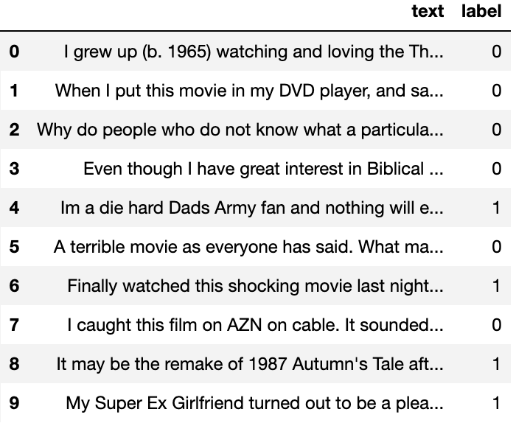
Dataset
Data used for analysis is retrieved from Kaggle and contains movie reviews for about 50,000.
The dataset contains two columns, text and label.
The text column contains all the movie reviews.
The label column contains 0 or 1.

Slide 5
Data Preprocessing
Steps implemented to process the data -
Tokenization
Stemming
Stop word removal

Slide 6
Methods
Exploratory Data Analysis
Classification models
Logistic Regression
Decision Tree
K-Nearest Neighbors

Slide 7
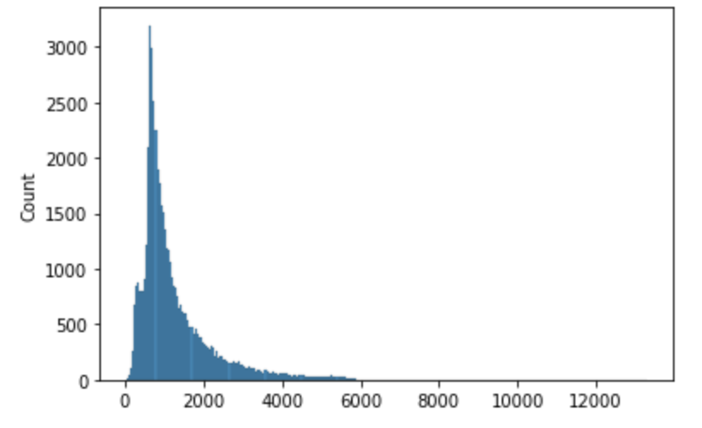
Distribution of text length
Fewer reviews have word count over 2000

Slide 8
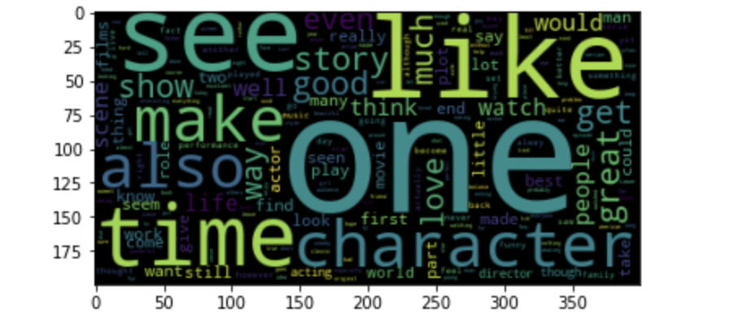
Word Cloud of Positive Words
Words like one, like, time, character, make etc., are most common words in reviews with positive sentiment

Slide 9
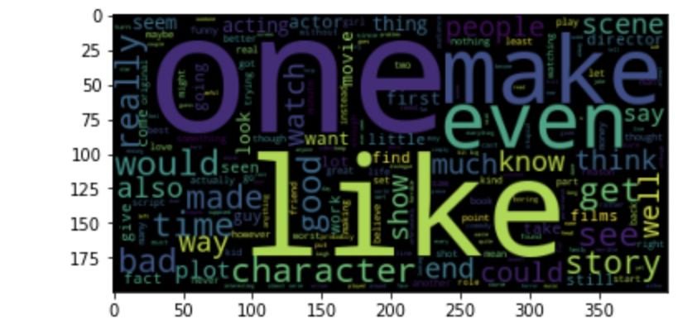
Word Cloud of Negative Words
Words like one, make, even, like, would etc., are most common words in reviews with negative sentiment

Slide 10
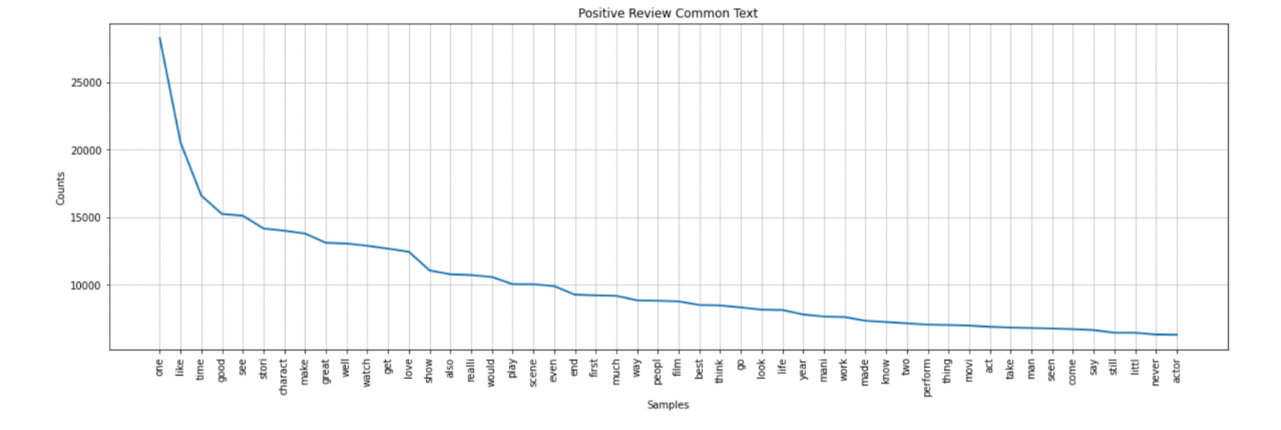
Most Frequent Positive words
“one” was the most common word that was used more than 25,000 times in the positive reviews, followed by like, time, good

Slide 11
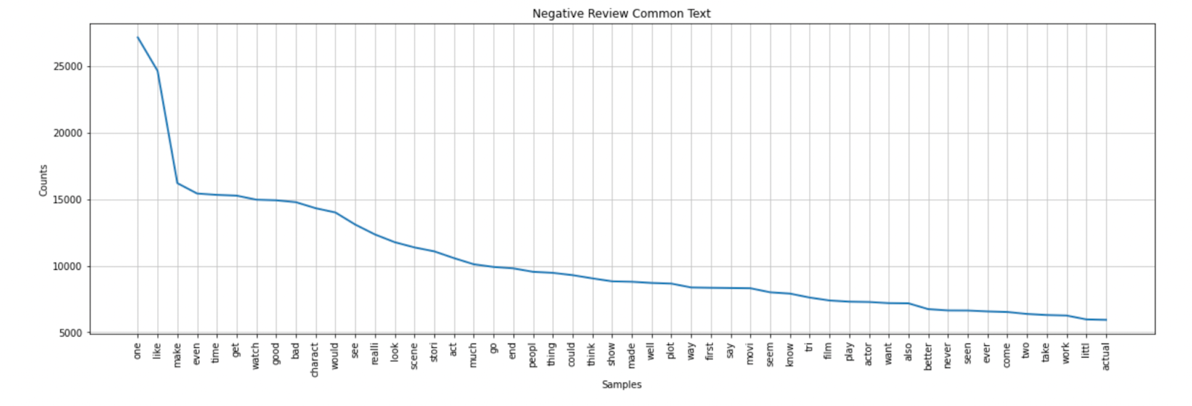
Most Frequent Negative words
“one” was the most common word in negative reviews and appeared more than 25,000 times, followed by like, make, even.

Slide 12
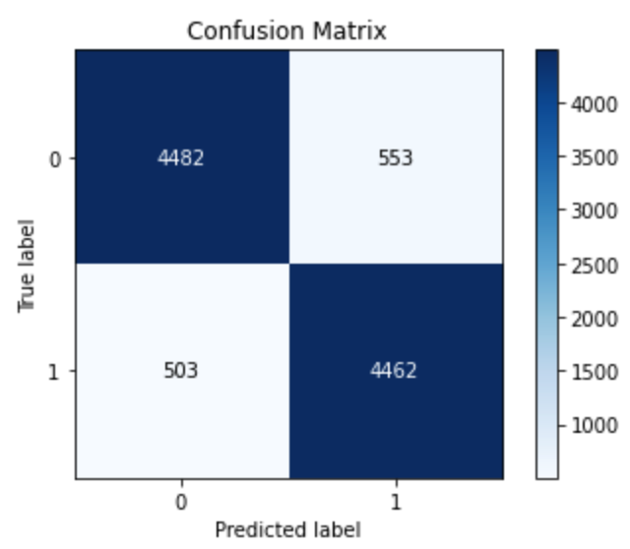
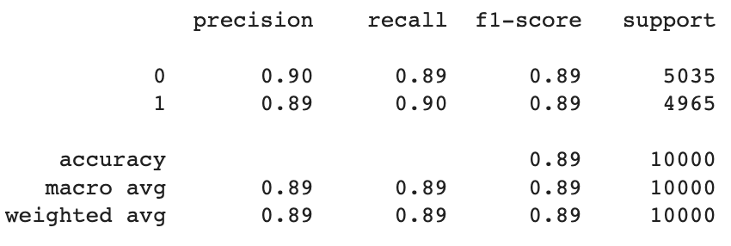
Logistic Regression
Accuracy obtained is 0.89
Weighted Average of Recall is 0.89
Weighted Average of Precision is 0.89

Slide 13
Decision Tree
Accuracy obtained is 0.89
Weighted Average of Recall is 0.89
Weighted Average of Precision is 0.89

Slide 14
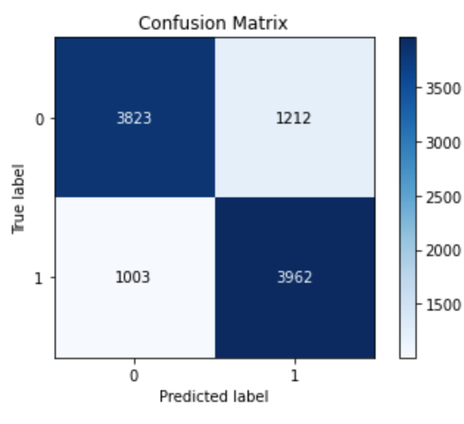
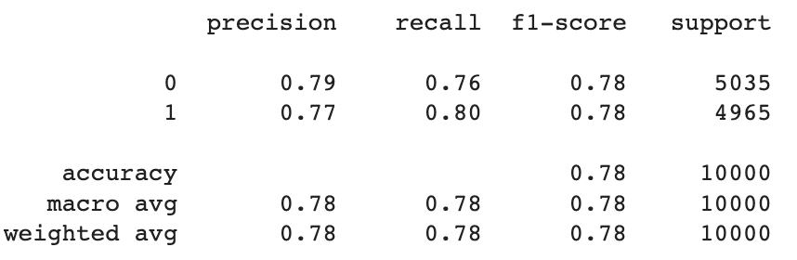
K-Nearest Neighbors
Accuracy obtained is 0.78
Weighted Average of Recall is 0.78
Weighted Average of Precision is 0.78

Slide 15
Conclusion
Models compared based on accuracy
Accuracy obtained for the models:
Logistic Regression – 89 %
Decision Tree – 89 %
K-Nearest Neighbors – 78 %
Logistic Regression, Decision Tree accuracy was higher

Slide 16
Future Work
Data with additional features
Model the data with Neural Networks

Slide 17
References
[1] W. P. Ramadhan, S. T. M. T. Astri Novianty and S. T. M. T. Casi Setianingsih, "Sentiment analysis using multinomial logistic regression," 2017 International Conference on Control, Electronics, Renewable Energy and Communications (ICCRC), 2017, pp. 46-49, doi: 10.1109/ICCEREC.2017.8226700.
[2] Das, B., & Chakraborty, S. (2018). An improved text sentiment classification model using TF-IDF and next word negation. arXiv preprint arXiv:1806.06407.
[3]. M. A. Friedl and C. E. Brodley, “Decision tree classification of land cover from remotely sensed data,” Remote sensing of environment, vol. 61, no. 3, pp. 399–409, 1997.
[4] Brownlee, J. (2021, January 21). Failure of classification accuracy for imbalanced class distributions. MachineLearningMastery.com. Retrieved December 10, 2022, from https://machinelearningmastery.com/failure-of-accuracy-for-imbalanced-class-distributions/#:~:text=Classification%20accuracy%20is%20a%20metric,used%20for%20evaluating%20classifier%20models.
[5] Shaukat, Z., Zulfiqar, A.A., Xiao, C. et al. Sentiment analysis on IMDB using lexicon and neural networks. SN Appl. Sci. 2, 148 (2020). https://doi.org/10.1007/s42452-019-1926-x
[6] Kumar, H. M., Harish, B. S., & Darshan, H. K. (2019). Sentiment Analysis on IMDb Movie Reviews Using Hybrid Feature Extraction Method. International Journal of Interactive Multimedia & Artificial Intelligence, 5(5).

